Slide 1


[高階會員專屬-第1期] 破解轉矩紋波，IEEE期刊論文導讀：Controller-Induced Parasitic Torque Ripples in a PM Synchronous Motor

Slide 2
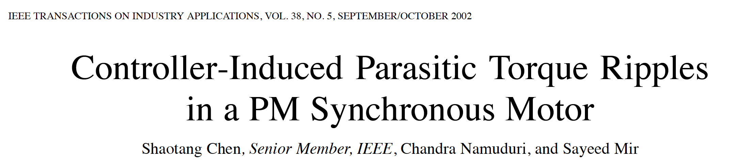
[高階會員專屬-第1期]破解轉矩紋波，IEEE期刊論文導讀：Controller-Induced Parasitic Torque Ripples in a PM Synchronous Motor

Slide 3
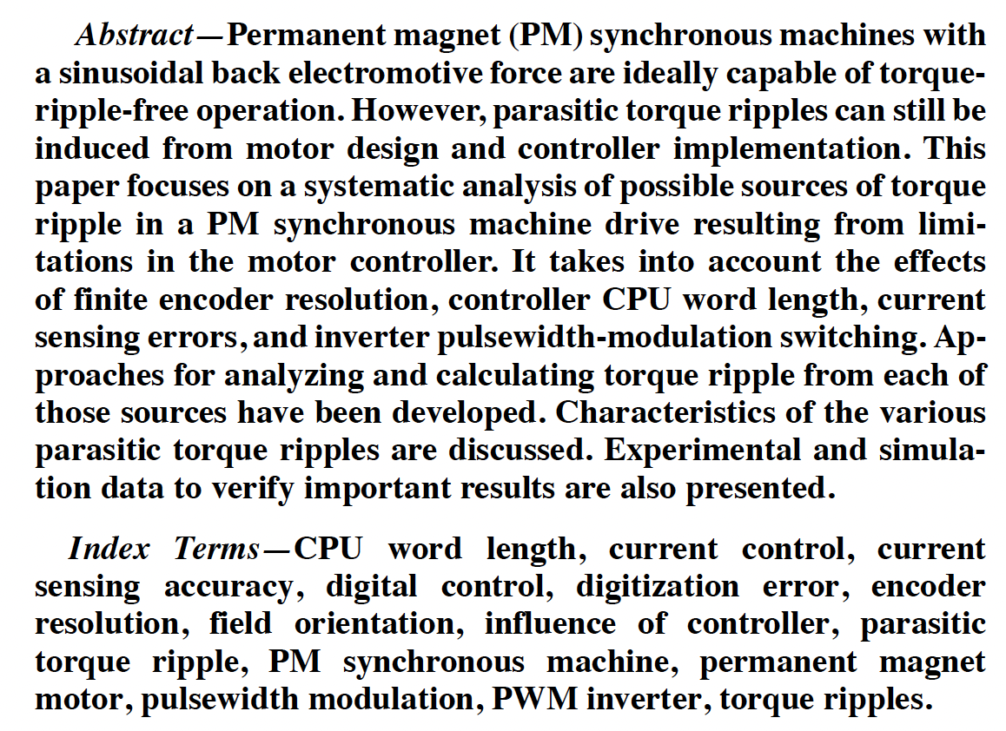
[高階會員專屬-第1期]破解轉矩紋波，IEEE期刊論文導讀：Controller-Induced Parasitic Torque Ripples in a PM Synchronous Motor
主要是對永磁同步馬達的轉矩紋波進行徹底的研究。
如馬達設計、編碼器解析度、CPU字長、電流感測誤差、PWM切換等…

Slide 4
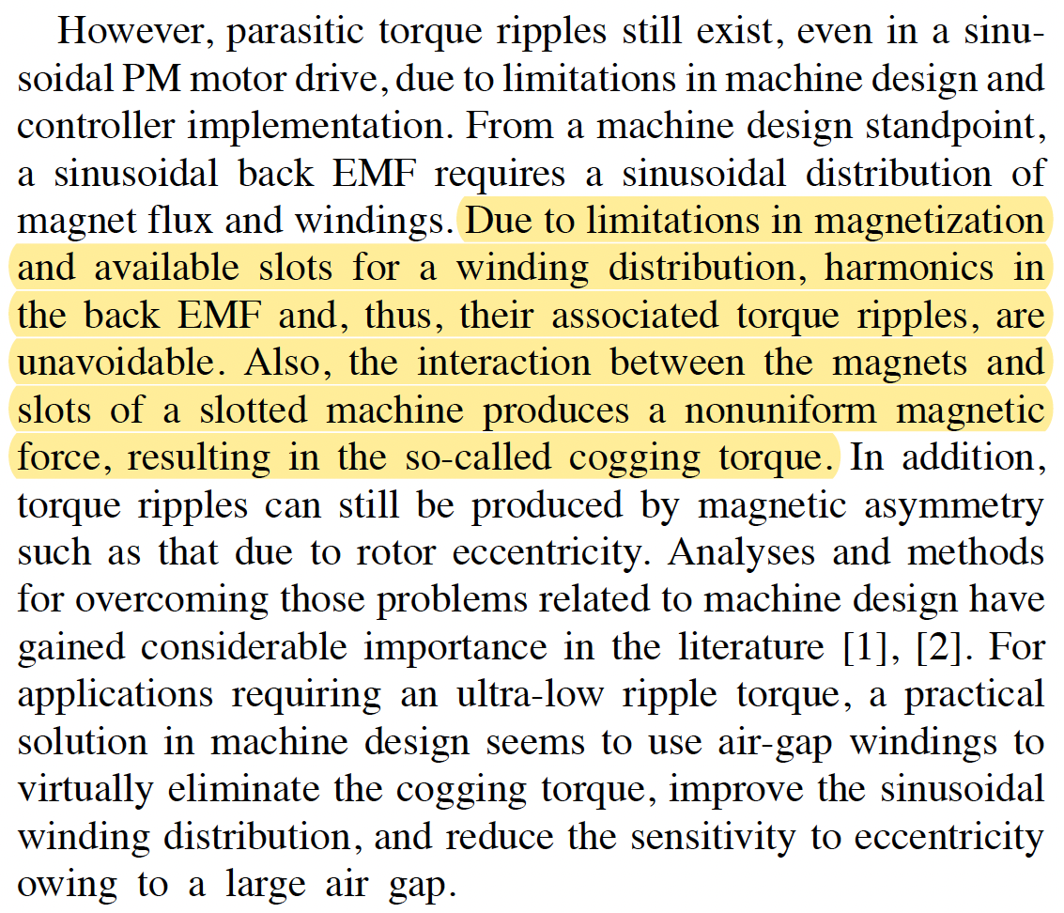
[高階會員專屬-第1期]破解轉矩紋波，IEEE期刊論文導讀：Controller-Induced Parasitic Torque Ripples in a PM Synchronous Motor
從馬達設計觀點，弦波反電動勢需要弦波繞組與磁通分布，由於定子繞組存在槽(slot)，因此會造成反電動勢的諧波，而造成轉矩紋波。
磁鐵與槽相互作用產生的非均勻磁動勢也會導致頓轉轉矩(cogging torque)
若要求極低的轉矩紋波，馬達設計會使用無槽式定子繞組設計。

Slide 5
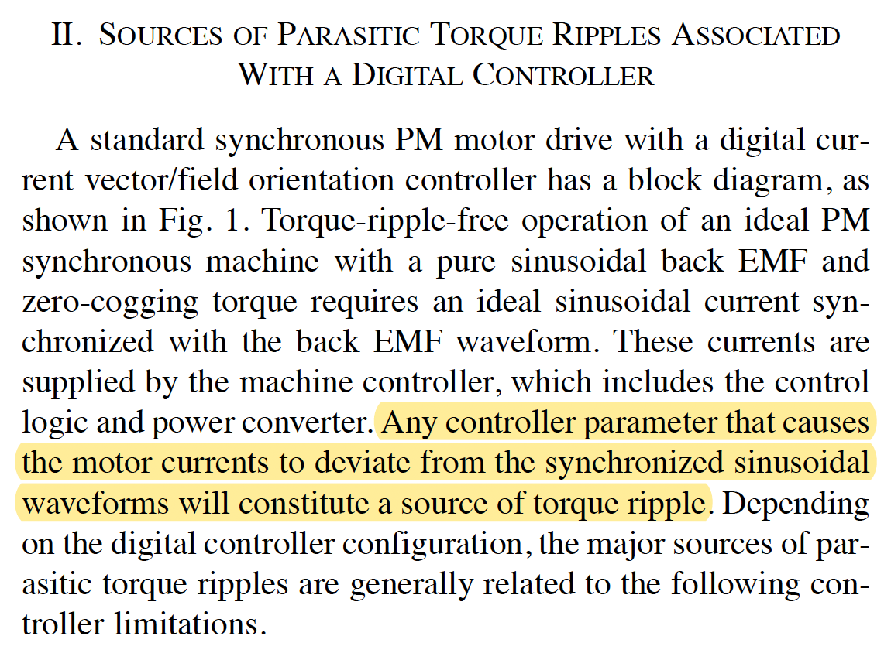
[高階會員專屬-第1期]破解轉矩紋波，IEEE期刊論文導讀：Controller-Induced Parasitic Torque Ripples in a PM Synchronous Motor
關於相電流為何需與相反電動勢同相位，可以參考
[老葉說事-175期]回答網友提問：如何計算永磁同步馬達反電動勢常數？

Slide 6
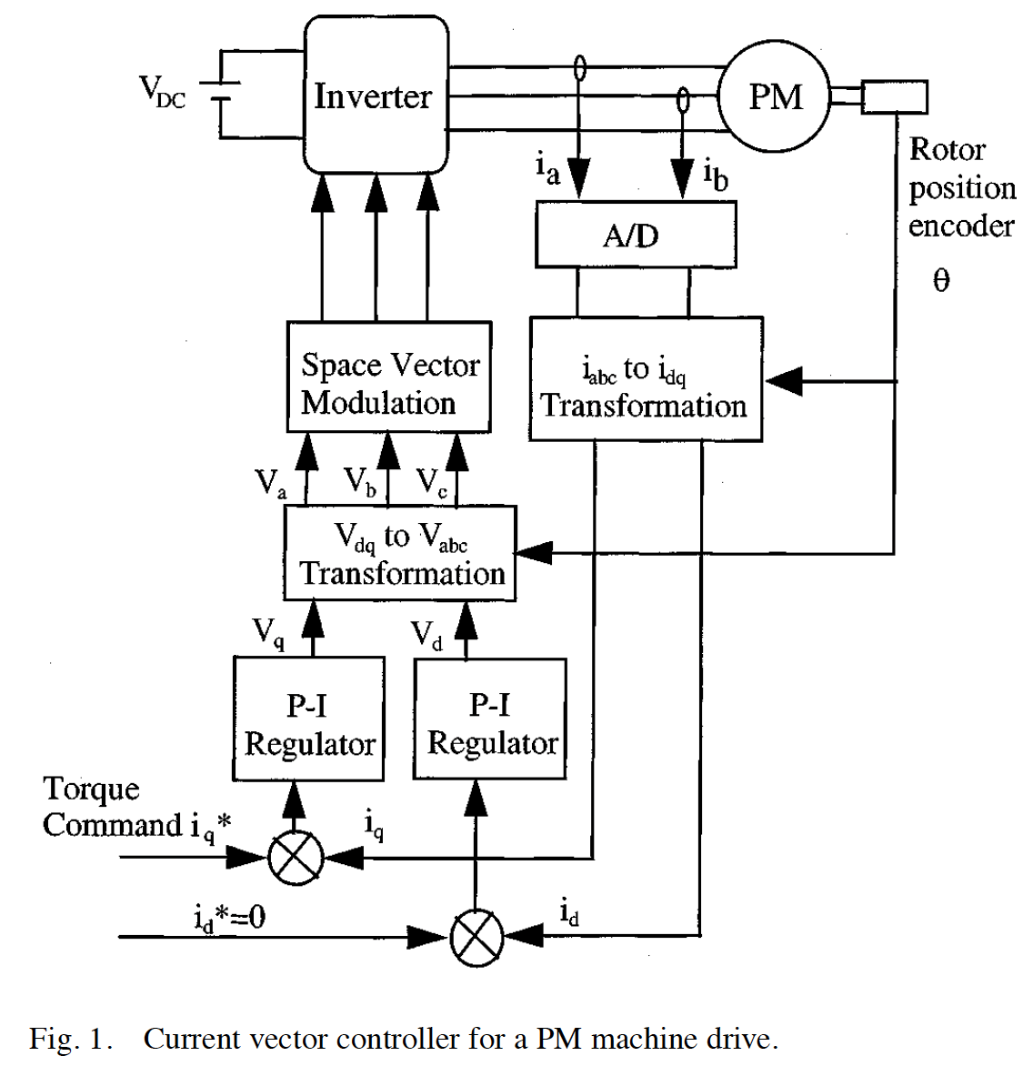
[高階會員專屬-第1期]破解轉矩紋波，IEEE期刊論文導讀：Controller-Induced Parasitic Torque Ripples in a PM Synchronous Motor

Slide 7
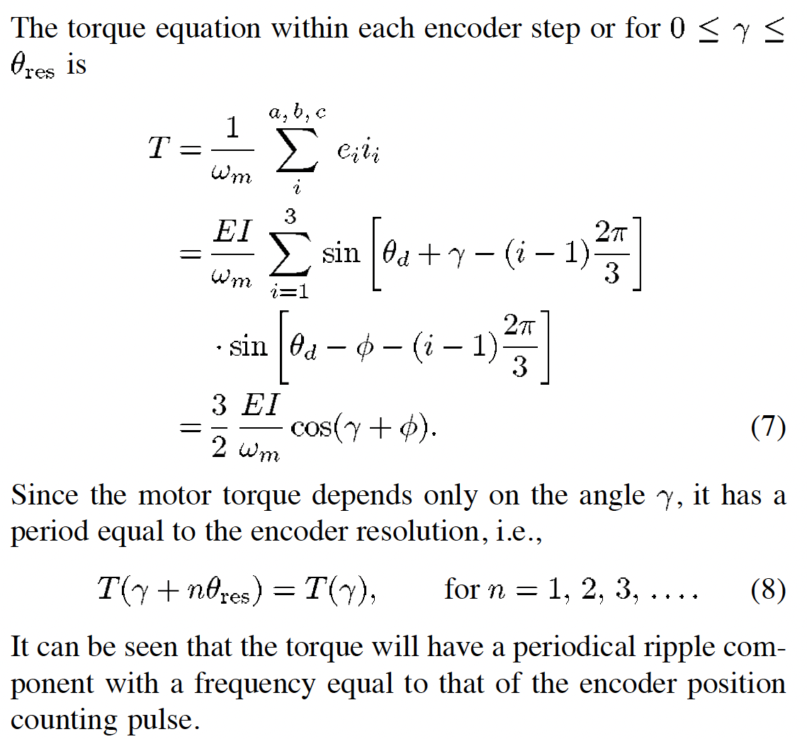
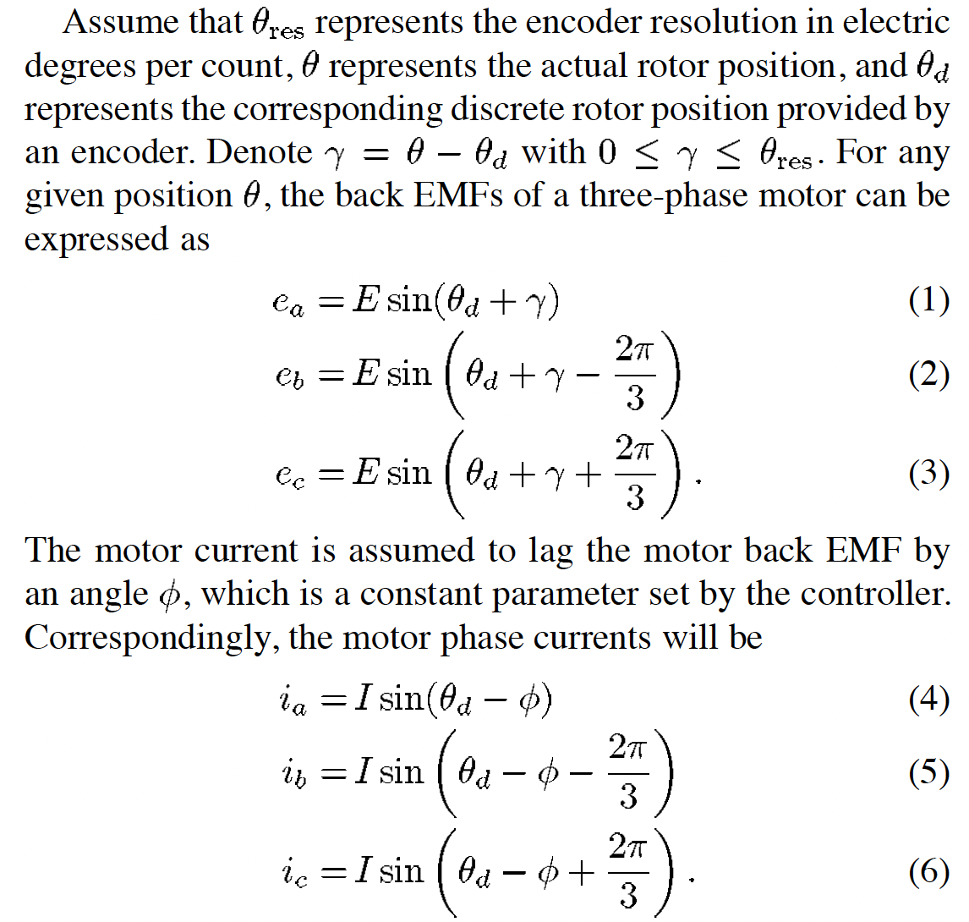

[高階會員專屬-第1期]破解轉矩紋波，IEEE期刊論文導讀：Controller-Induced Parasitic Torque Ripples in a PM Synchronous Motor
說明：若$θ_{res}=\frac{2π}{1000}$，$n=1000$

Slide 8
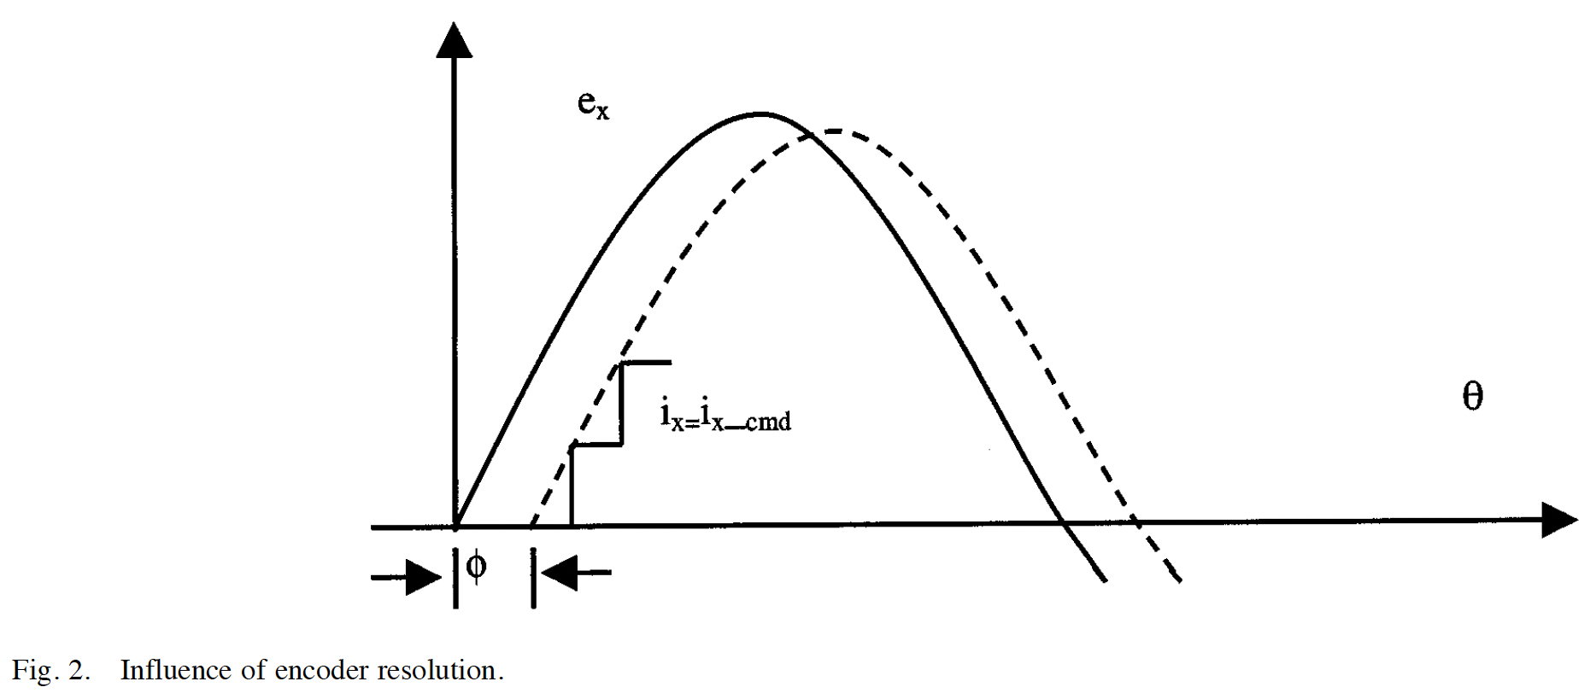
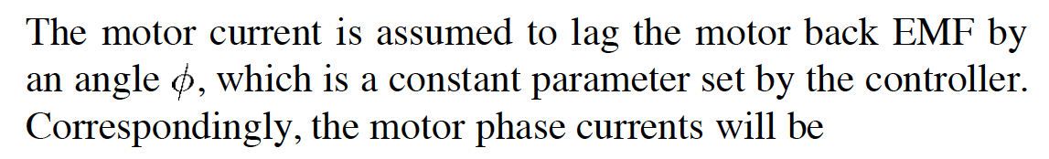
[高階會員專屬-第1期]破解轉矩紋波，IEEE期刊論文導讀：Controller-Induced Parasitic Torque Ripples in a PM Synchronous Motor

Slide 9
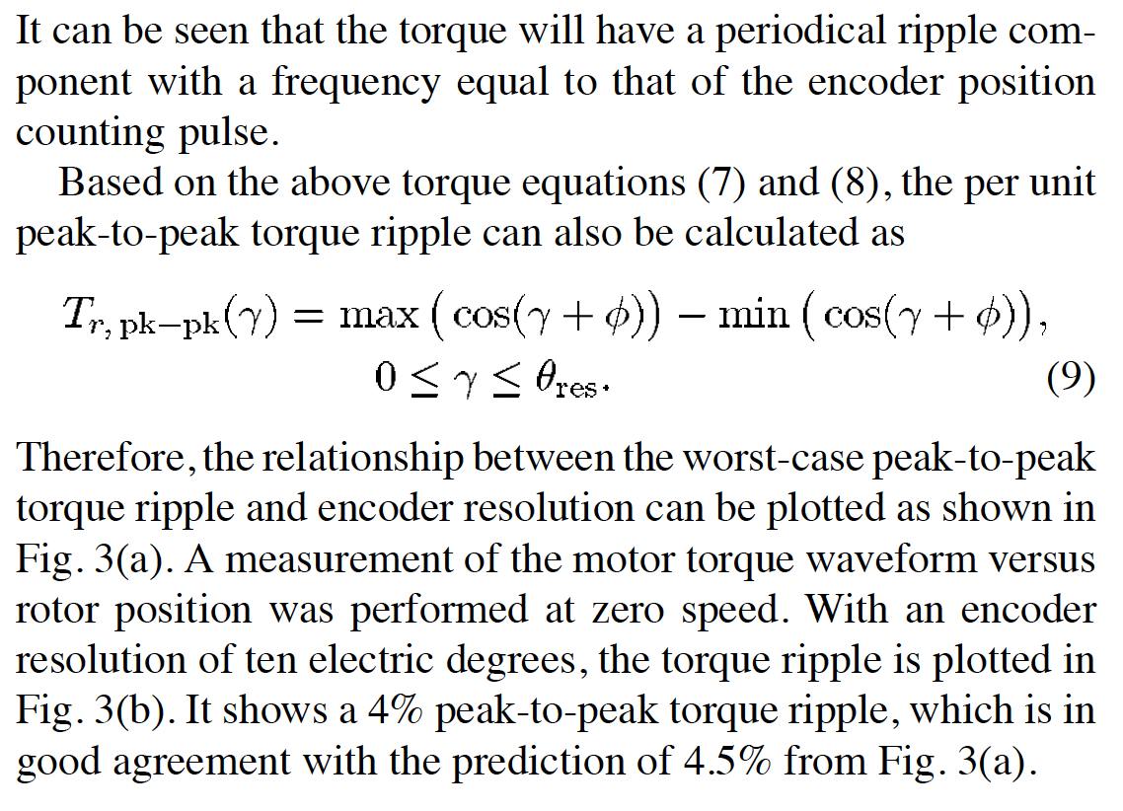
[高階會員專屬-第1期]破解轉矩紋波，IEEE期刊論文導讀：Controller-Induced Parasitic Torque Ripples in a PM Synchronous Motor

Slide 10
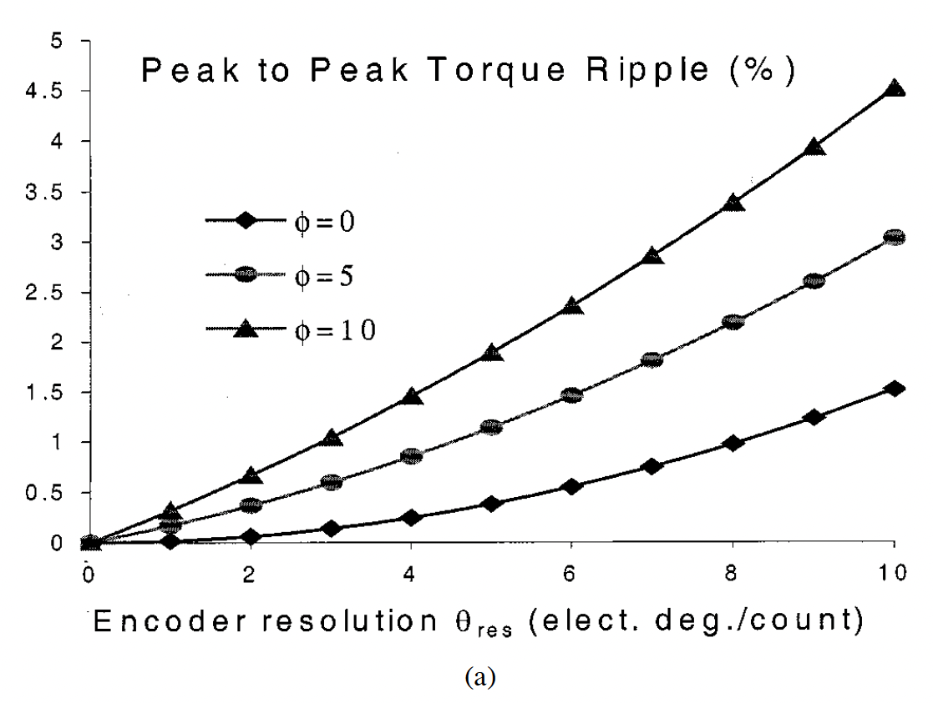
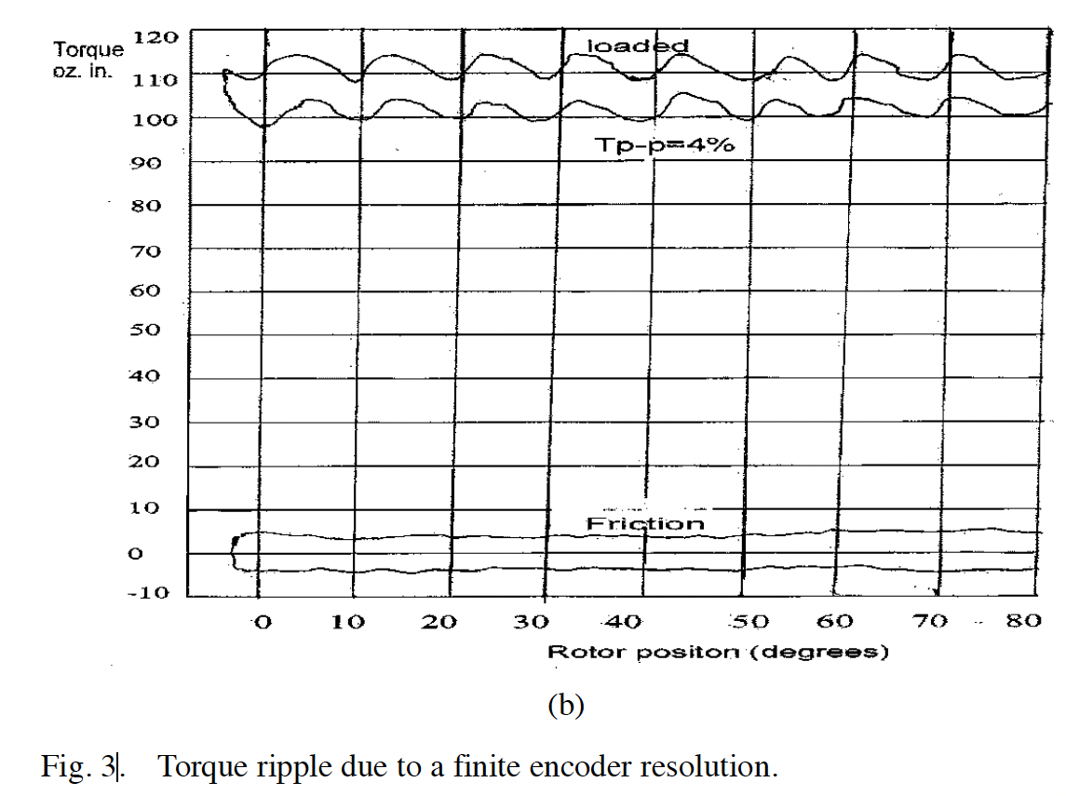
[高階會員專屬-第1期]破解轉矩紋波，IEEE期刊論文導讀：Controller-Induced Parasitic Torque Ripples in a PM Synchronous Motor

Slide 11
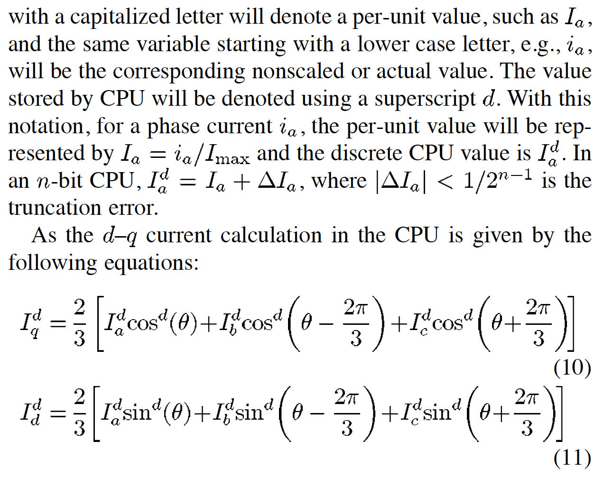
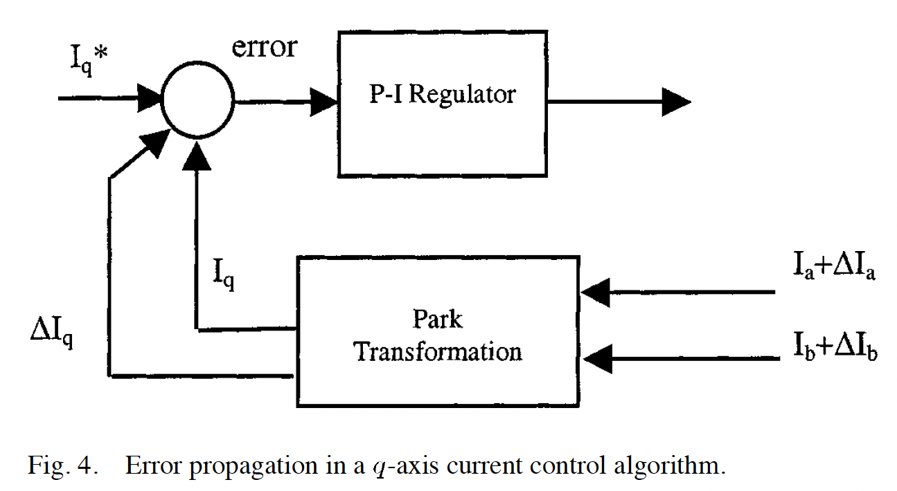
[高階會員專屬-第1期]破解轉矩紋波，IEEE期刊論文導讀：Controller-Induced Parasitic Torque Ripples in a PM Synchronous Motor

Slide 12
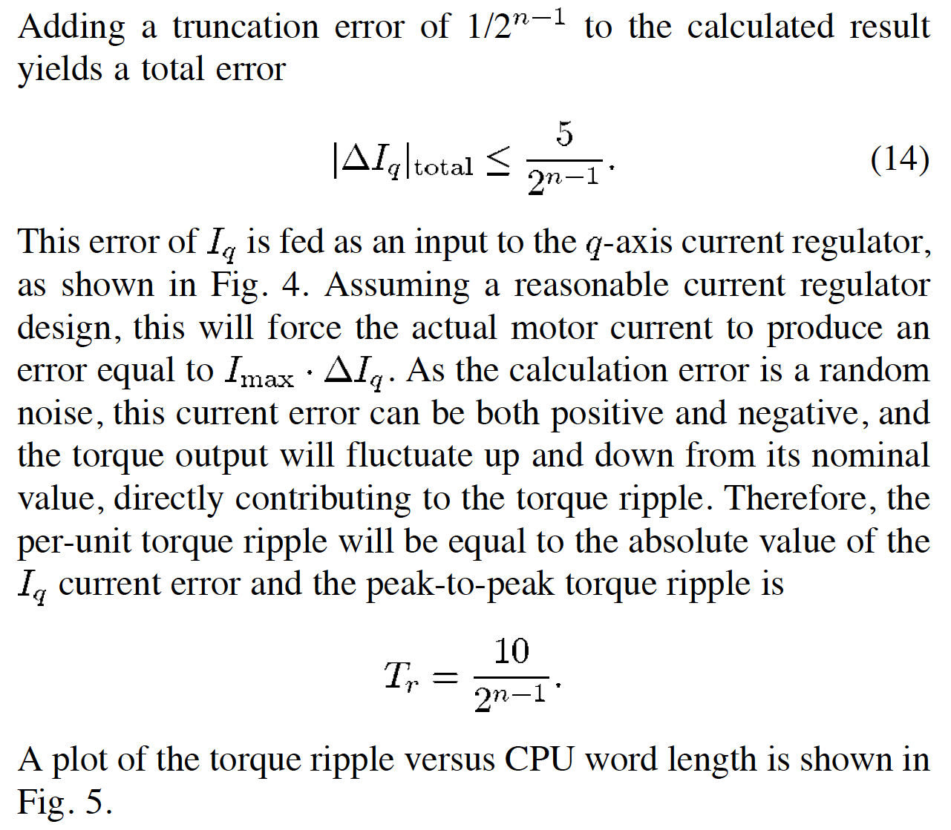
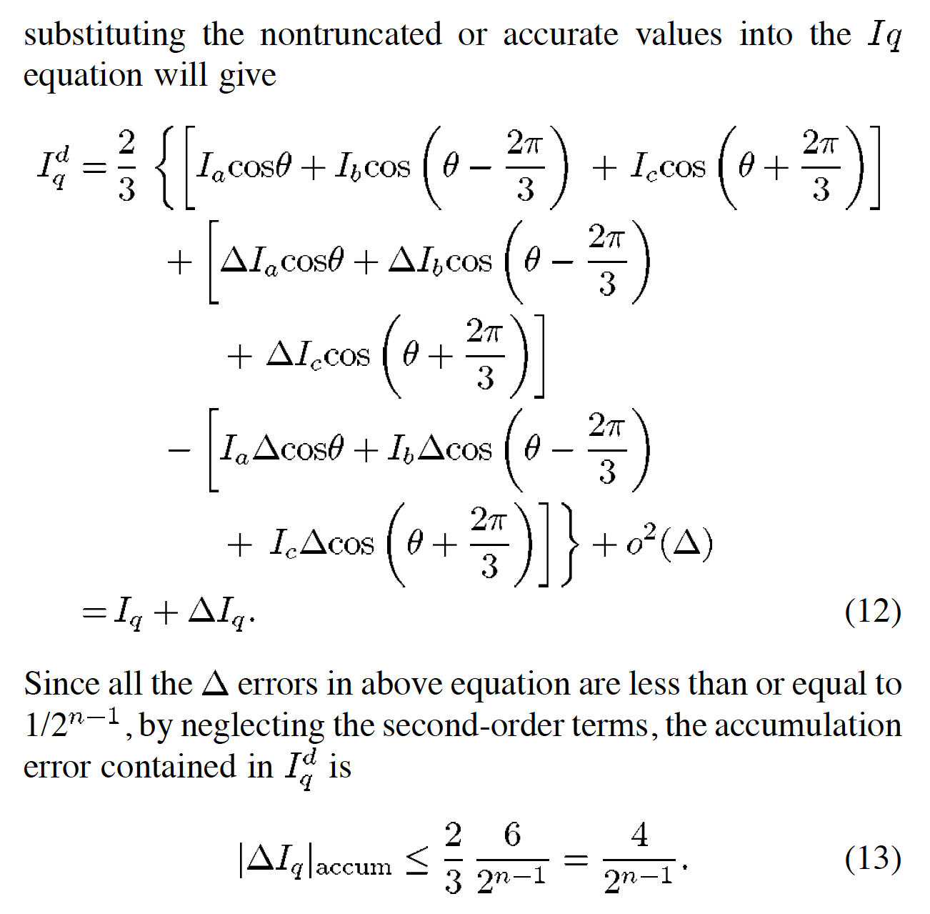
[高階會員專屬-第1期]破解轉矩紋波，IEEE期刊論文導讀：Controller-Induced Parasitic Torque Ripples in a PM Synchronous Motor

Slide 13
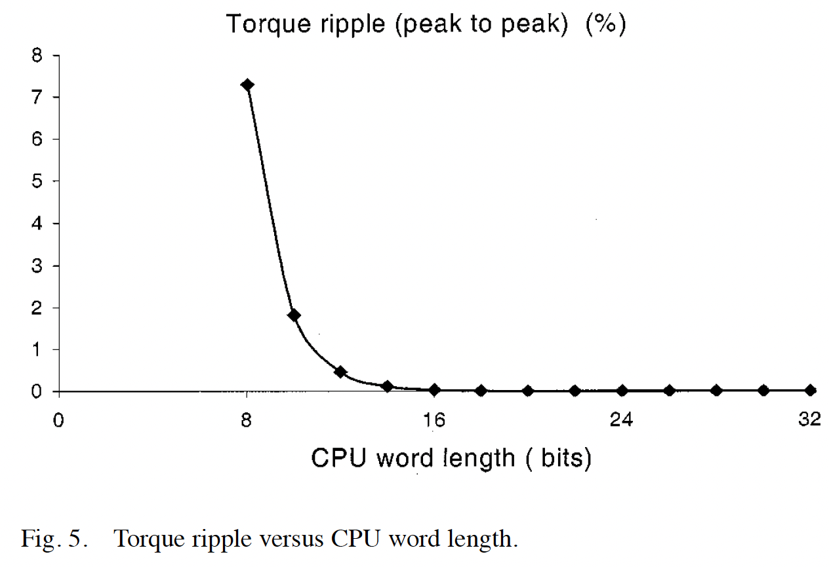
[高階會員專屬-第1期]破解轉矩紋波，IEEE期刊論文導讀：Controller-Induced Parasitic Torque Ripples in a PM Synchronous Motor

Slide 14
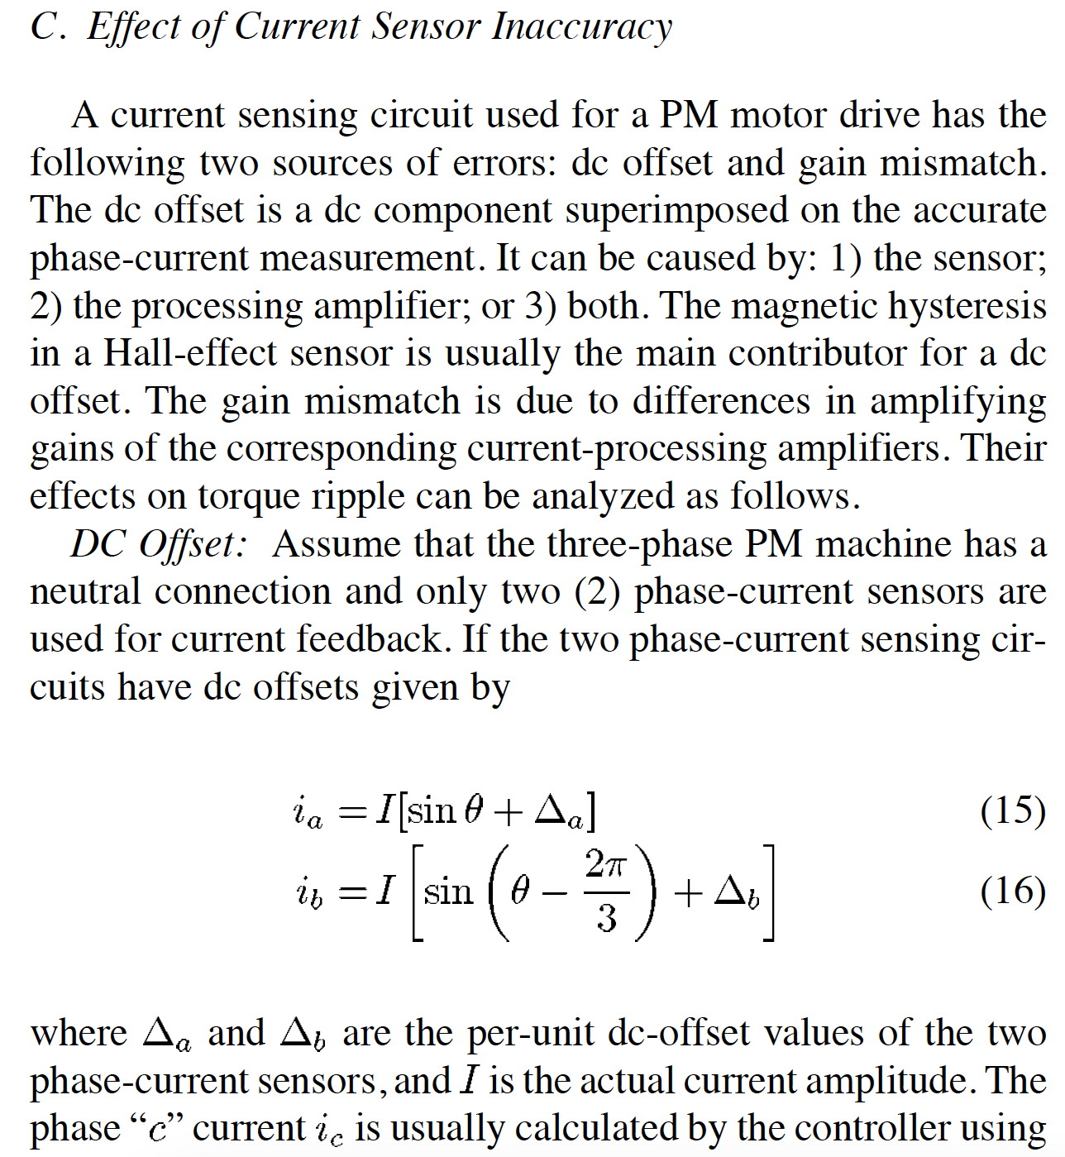
[高階會員專屬-第1期]破解轉矩紋波，IEEE期刊論文導讀：Controller-Induced Parasitic Torque Ripples in a PM Synchronous Motor

Slide 15
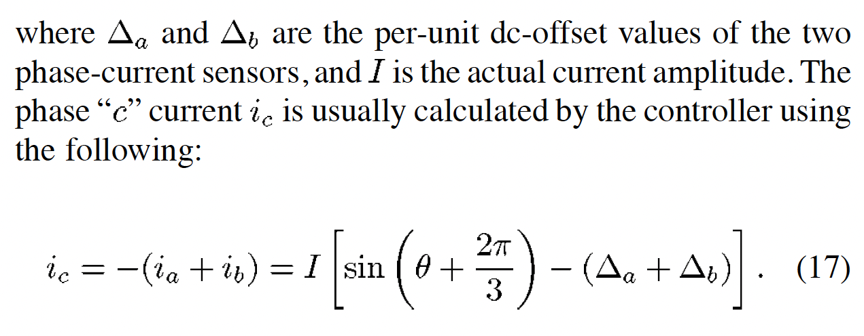
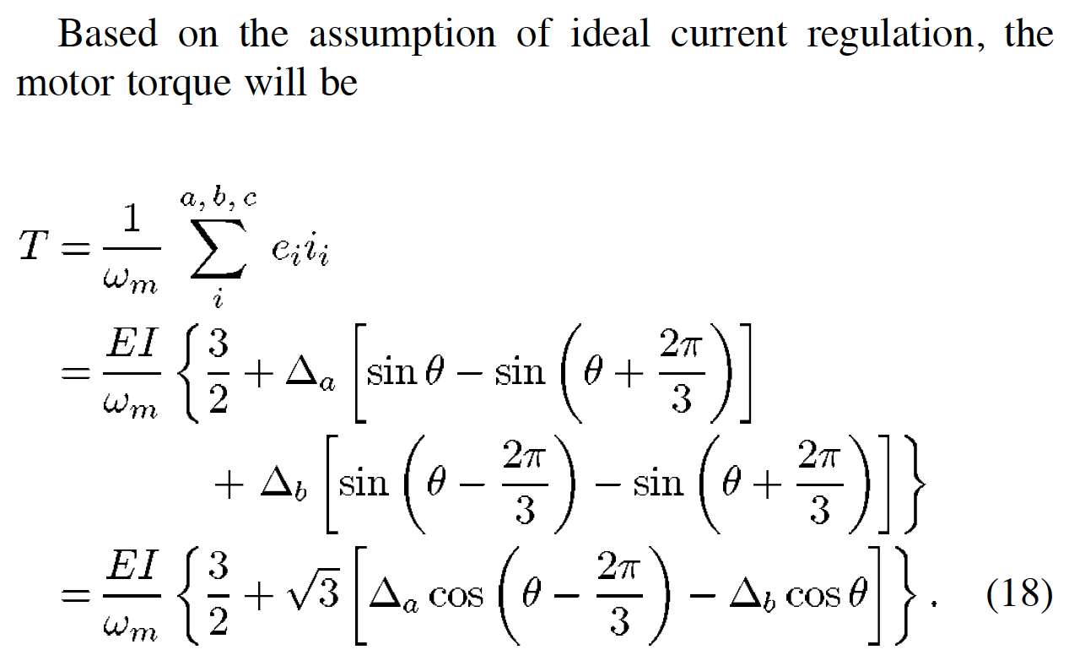
[高階會員專屬-第1期]破解轉矩紋波，IEEE期刊論文導讀：Controller-Induced Parasitic Torque Ripples in a PM Synchronous Motor

Slide 16
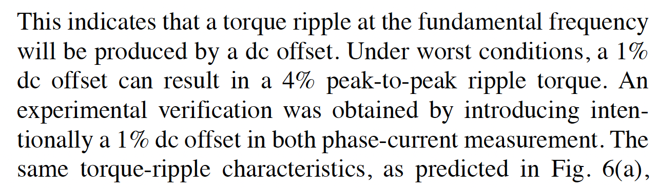
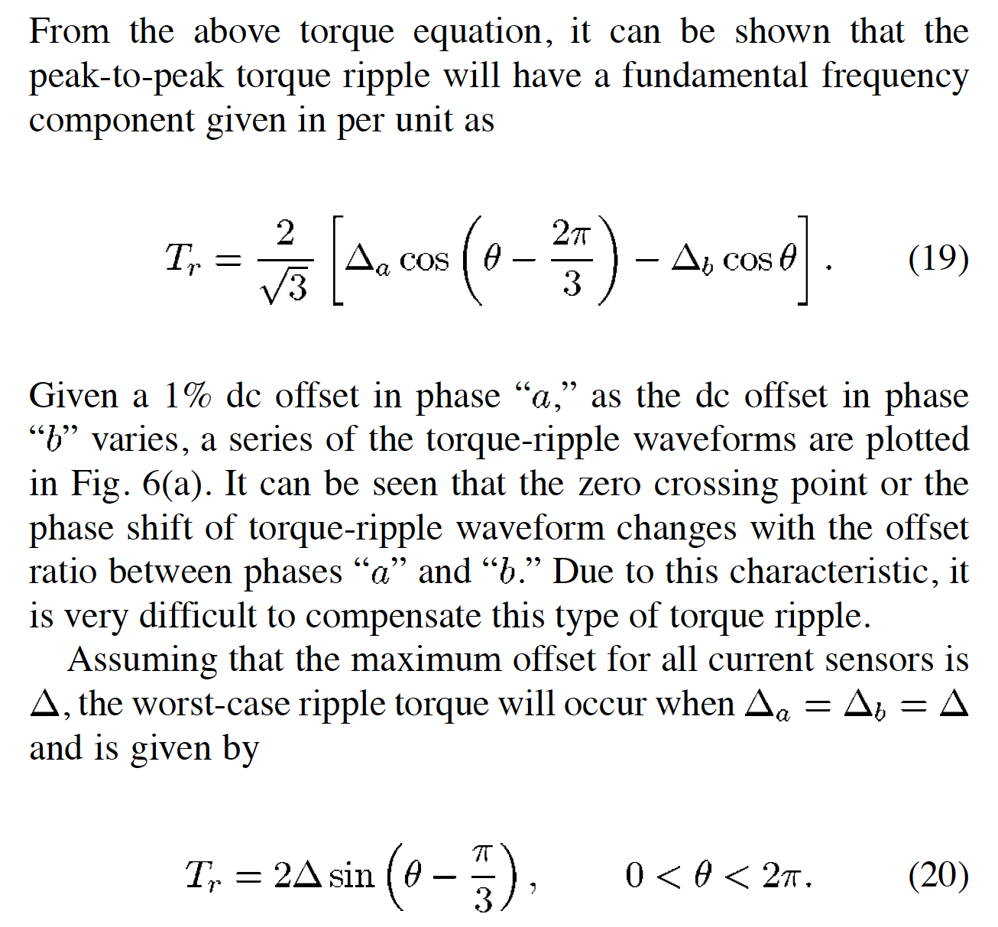
[高階會員專屬-第1期]破解轉矩紋波，IEEE期刊論文導讀：Controller-Induced Parasitic Torque Ripples in a PM Synchronous Motor

Slide 17
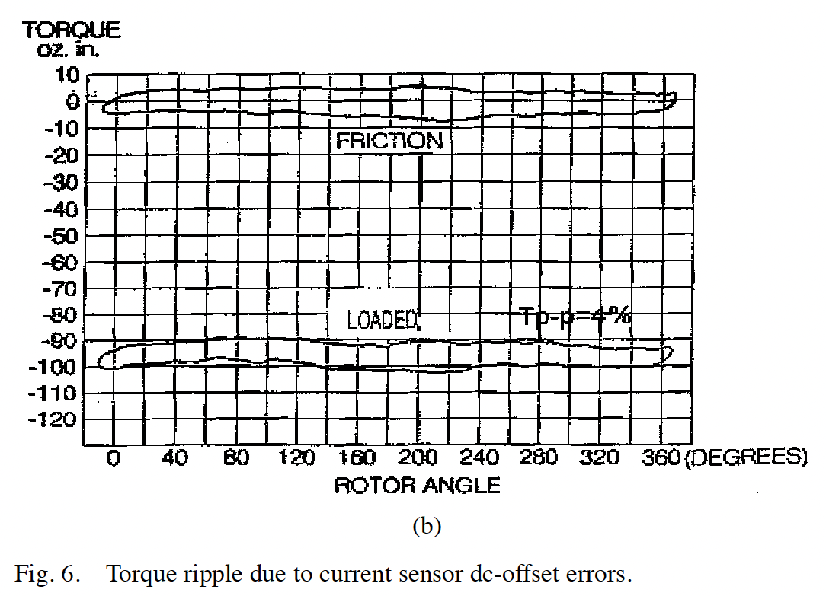
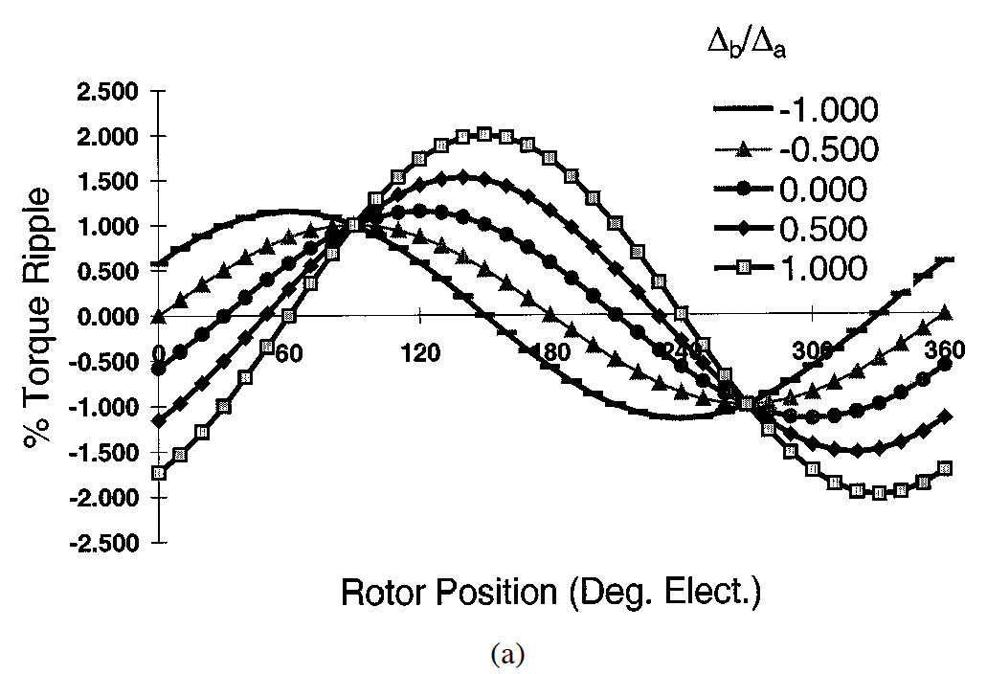
[高階會員專屬-第1期]破解轉矩紋波，IEEE期刊論文導讀：Controller-Induced Parasitic Torque Ripples in a PM Synchronous Motor

Slide 18
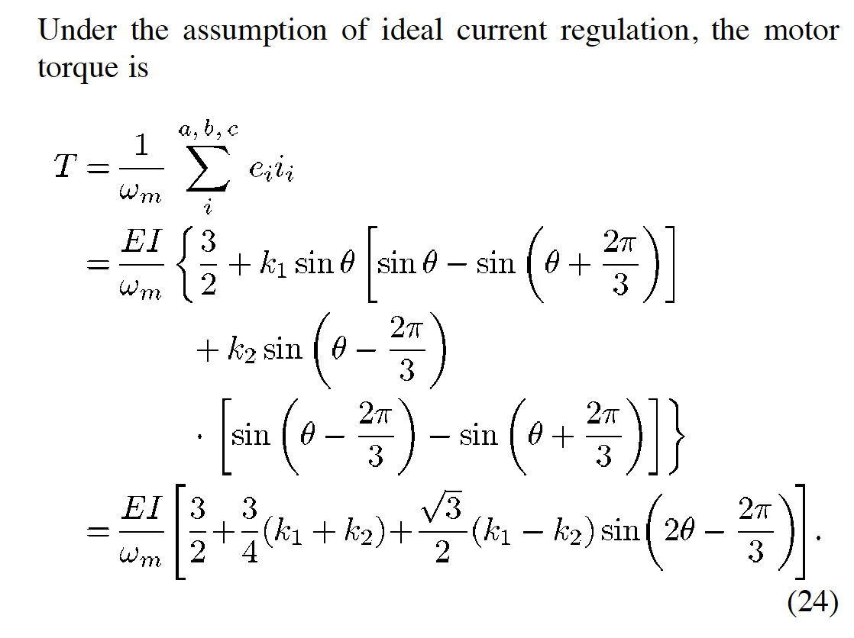
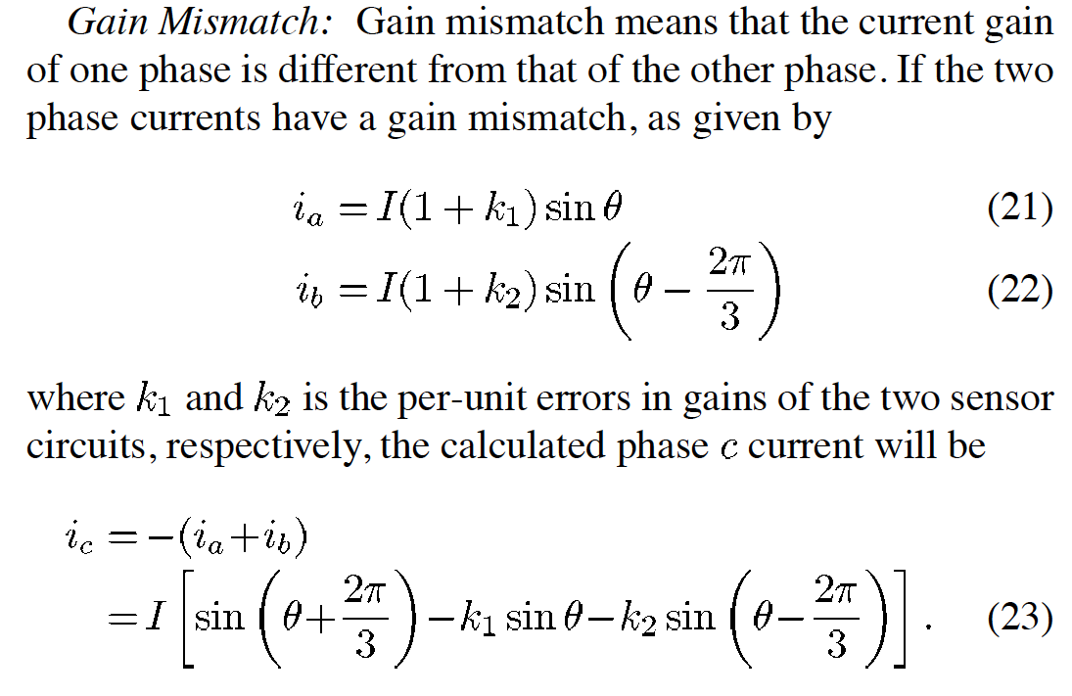
[高階會員專屬-第1期]破解轉矩紋波，IEEE期刊論文導讀：Controller-Induced Parasitic Torque Ripples in a PM Synchronous Motor

Slide 19
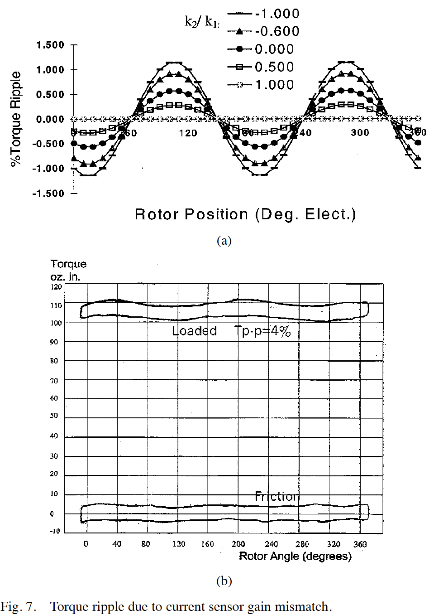
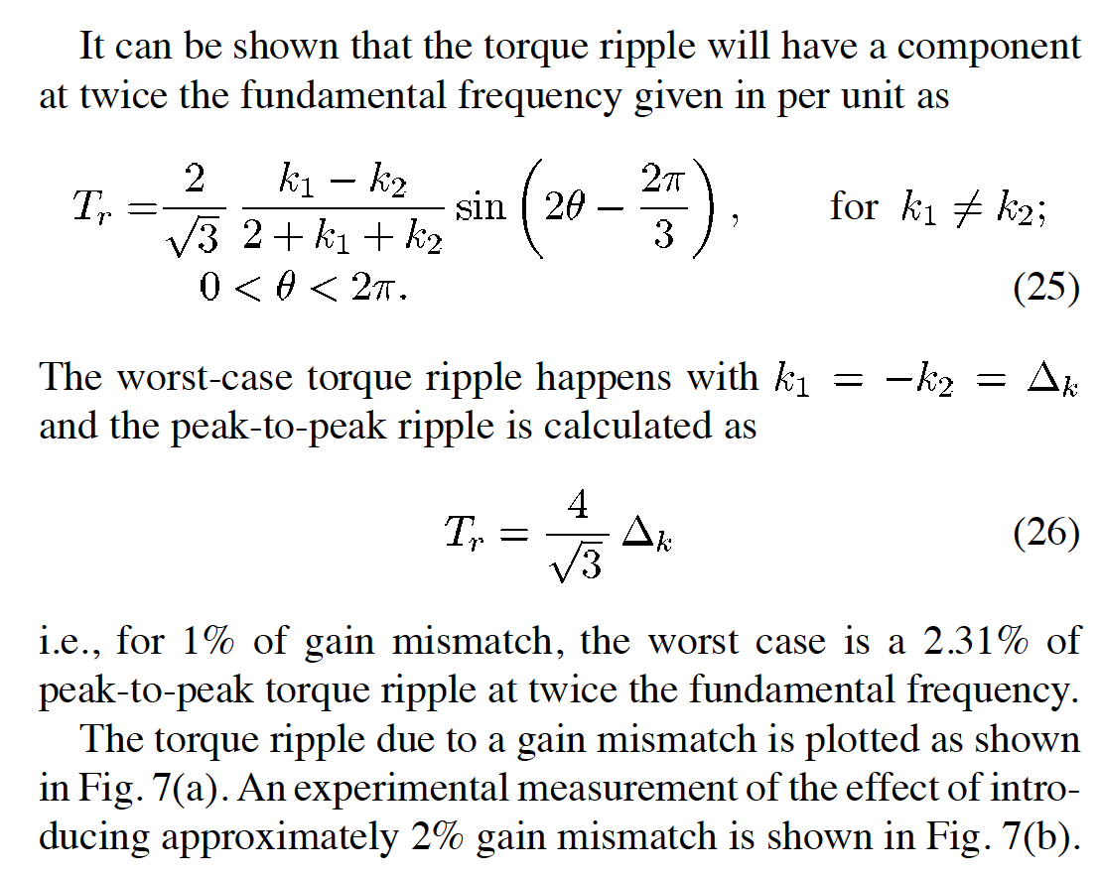

Slide 20
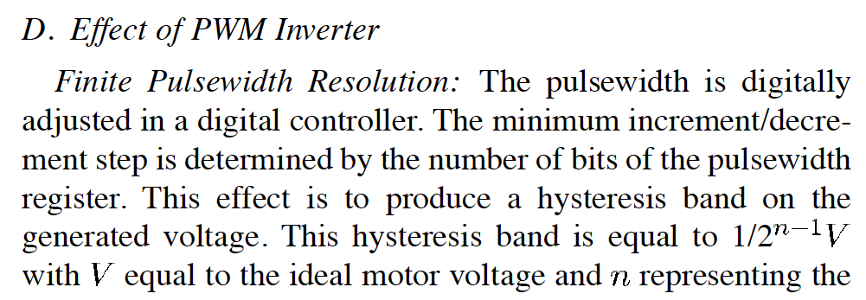
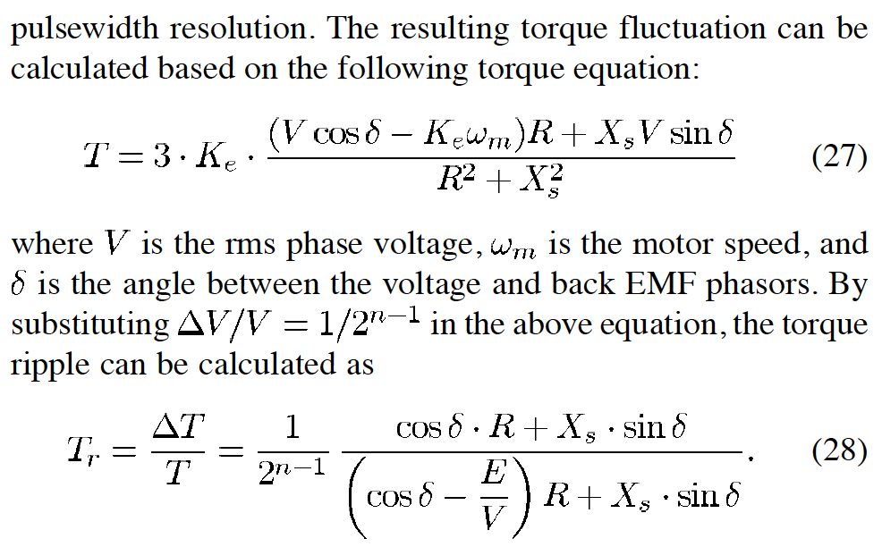
[高階會員專屬-第1期]破解轉矩紋波，IEEE期刊論文導讀：Controller-Induced Parasitic Torque Ripples in a PM Synchronous Motor

Slide 21
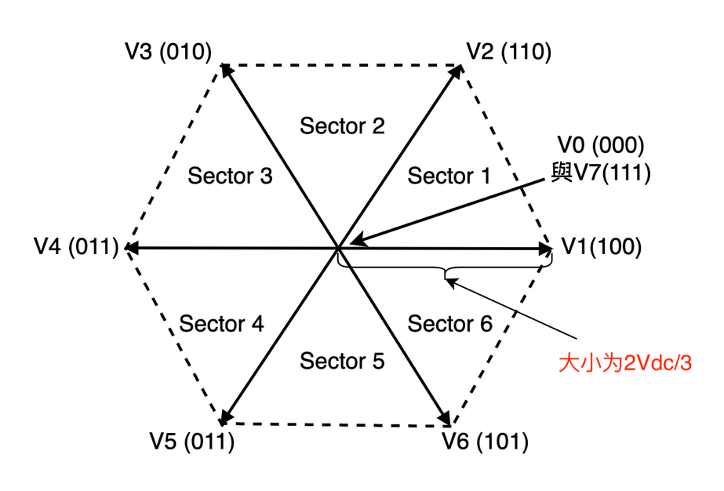
[高階會員專屬-第1期]破解轉矩紋波，IEEE期刊論文導讀：Controller-Induced Parasitic Torque Ripples in a PM Synchronous Motor

Slide 22
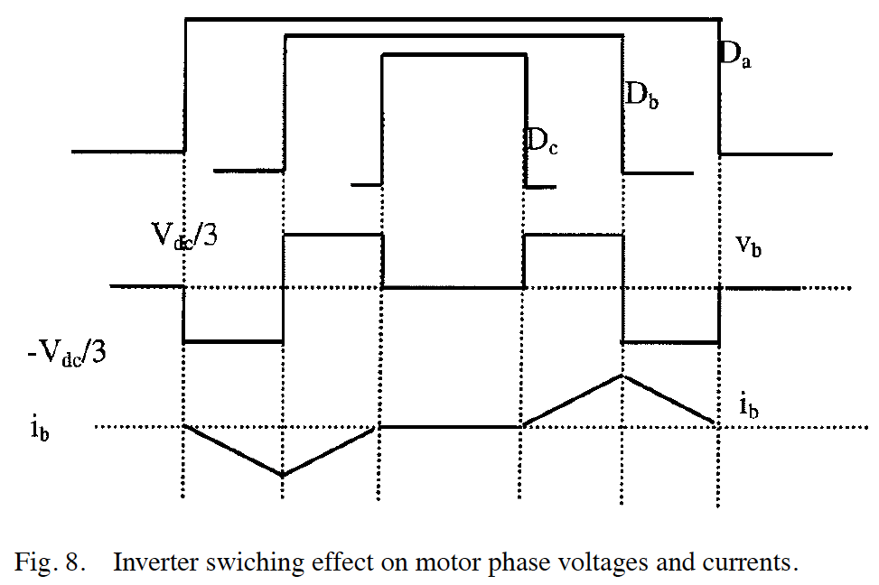
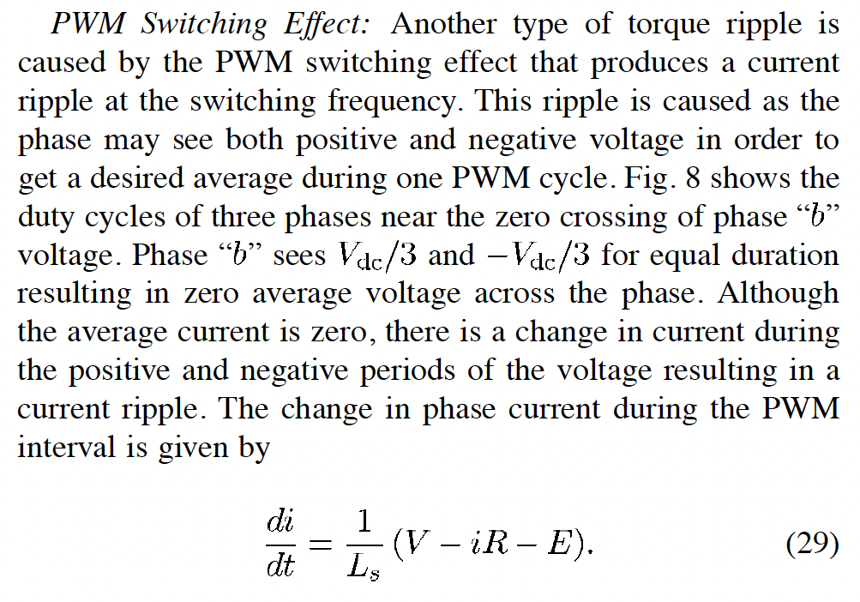
[高階會員專屬-第1期]破解轉矩紋波，IEEE期刊論文導讀：Controller-Induced Parasitic Torque Ripples in a PM Synchronous Motor

Slide 23
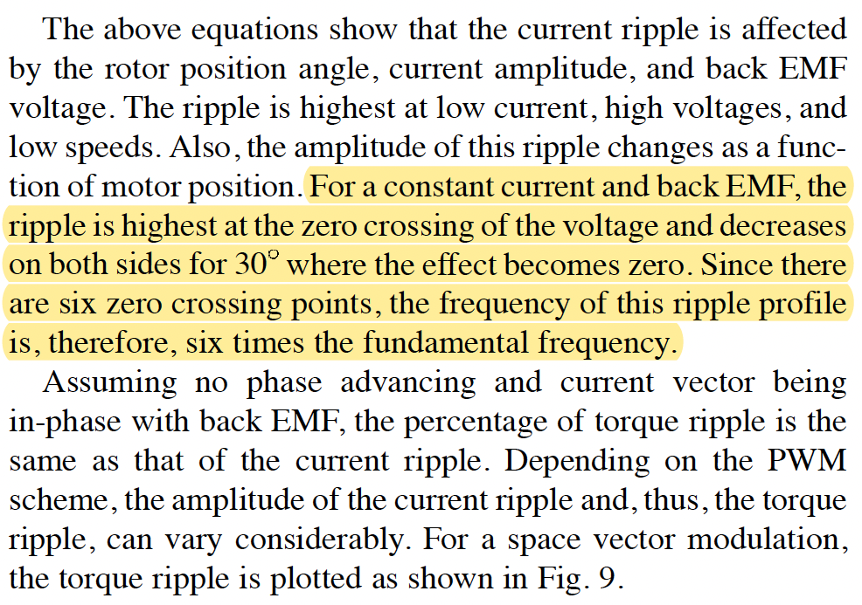
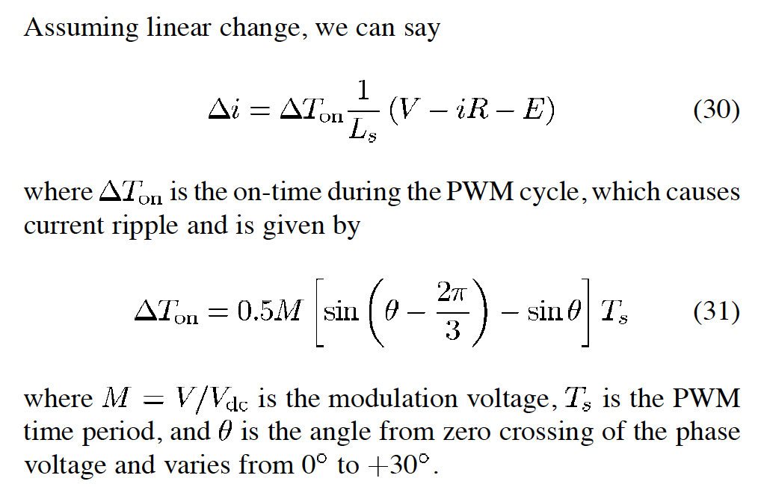
[高階會員專屬-第1期]破解轉矩紋波，IEEE期刊論文導讀：Controller-Induced Parasitic Torque Ripples in a PM Synchronous Motor

Slide 24
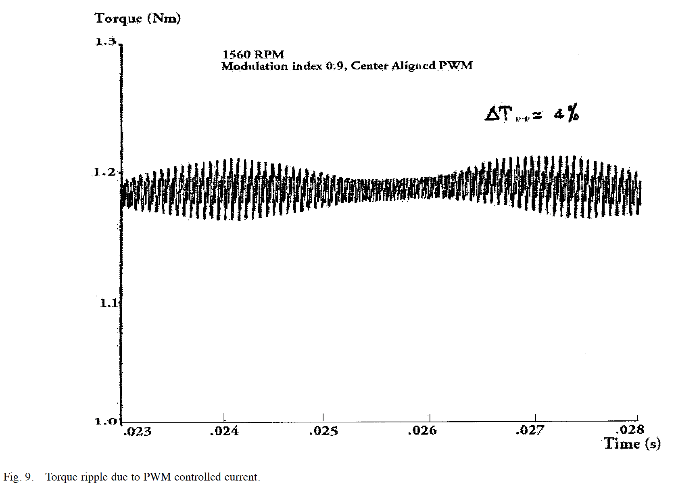
[高階會員專屬-第1期]破解轉矩紋波，IEEE期刊論文導讀：Controller-Induced Parasitic Torque Ripples in a PM Synchronous Motor

Slide 25
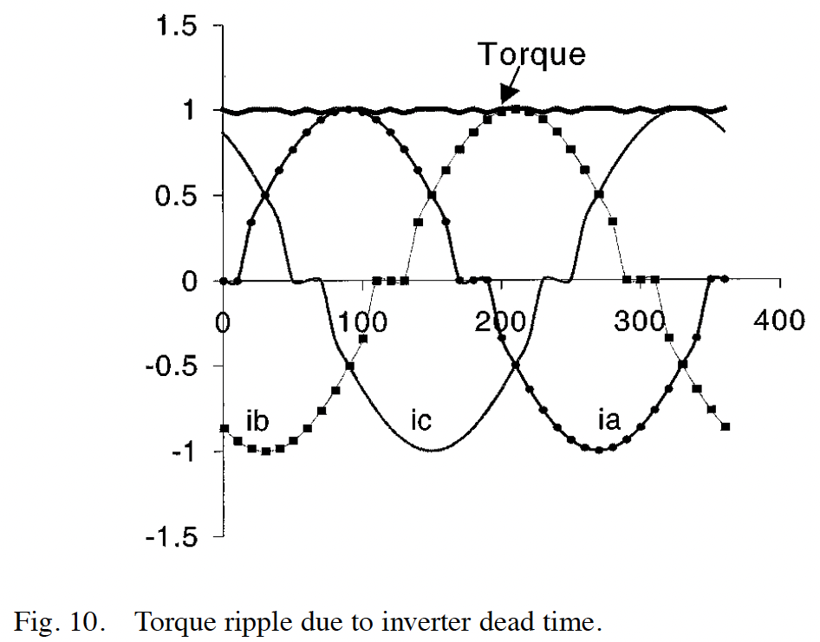
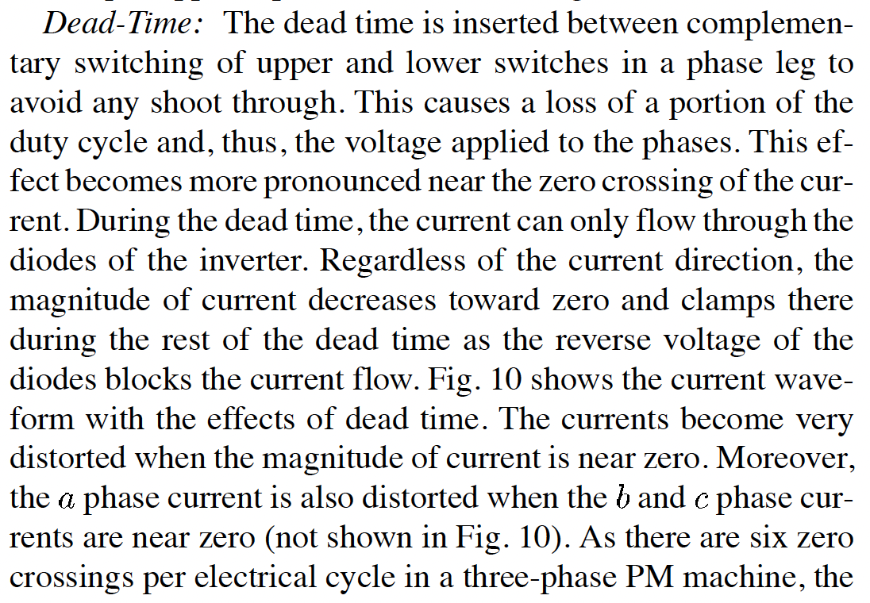
[高階會員專屬-第1期]破解轉矩紋波，IEEE期刊論文導讀：Controller-Induced Parasitic Torque Ripples in a PM Synchronous Motor

Slide 26
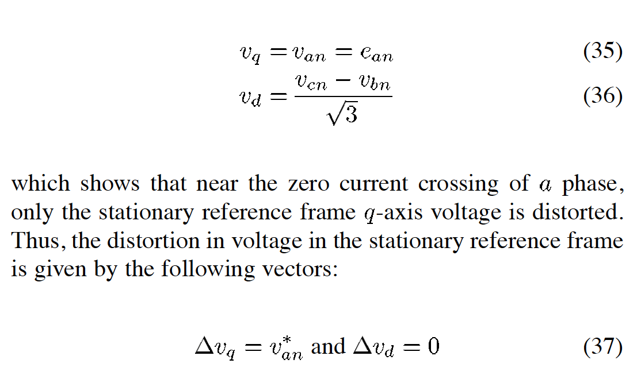
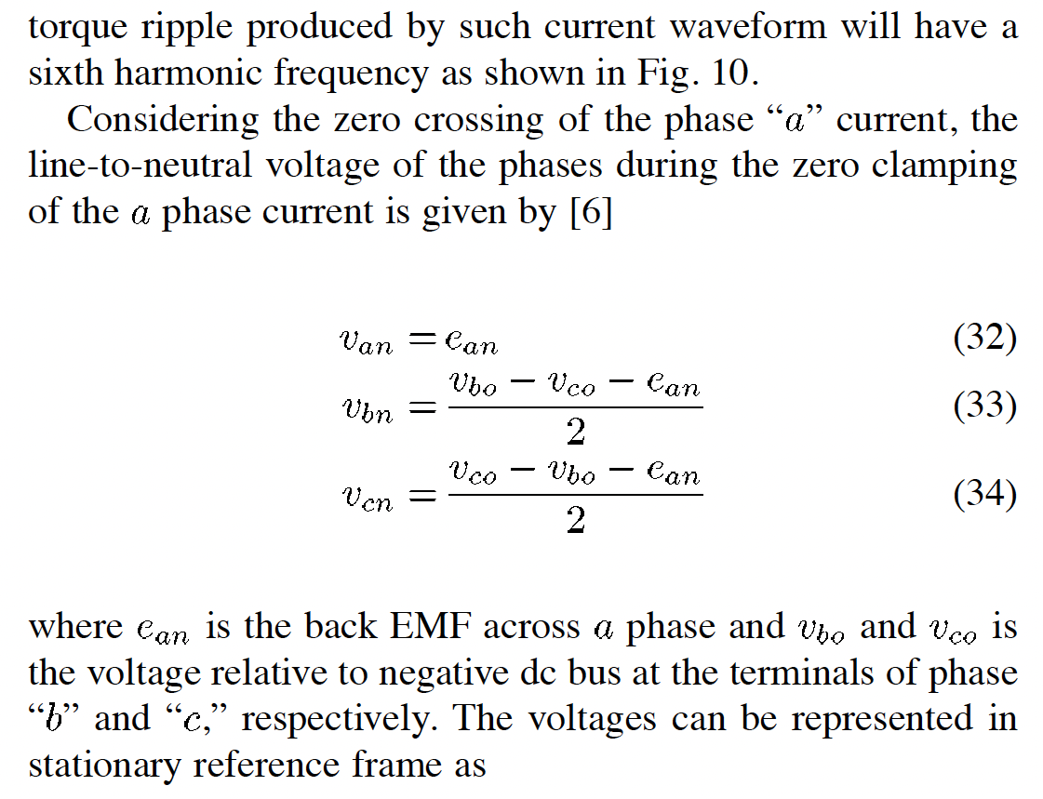
[高階會員專屬-第1期]破解轉矩紋波，IEEE期刊論文導讀：Controller-Induced Parasitic Torque Ripples in a PM Synchronous Motor

Slide 27
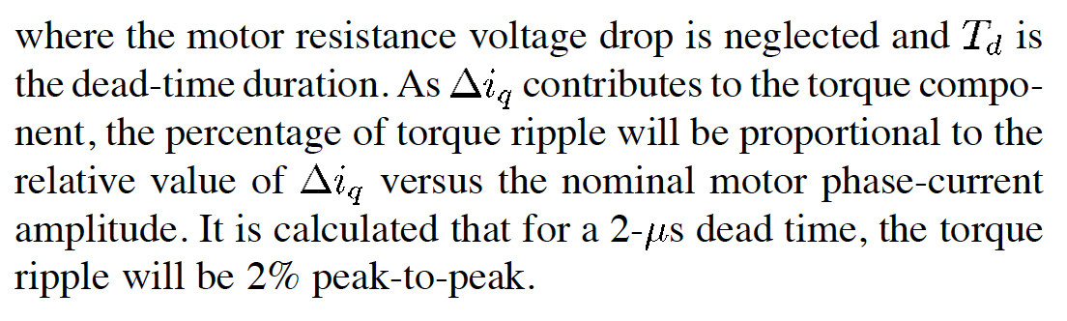
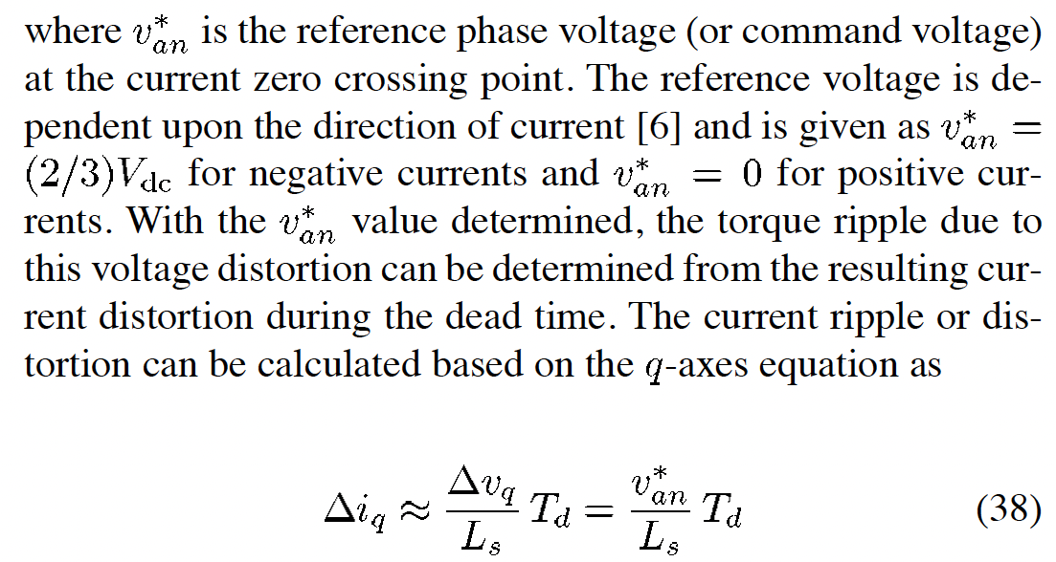
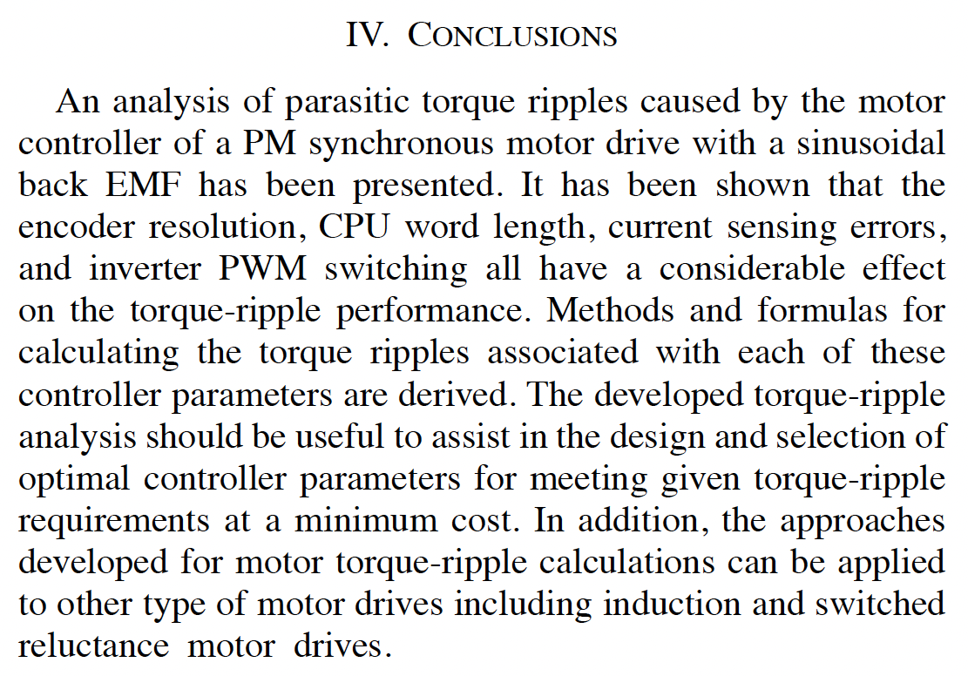
[高階會員專屬-第1期]破解轉矩紋波，IEEE期刊論文導讀：Controller-Induced Parasitic Torque Ripples in a PM Synchronous Motor

Slide 28
[高階會員專屬-第1期]破解轉矩紋波，IEEE期刊論文導讀：Controller-Induced Parasitic Torque Ripples in a PM Synchronous Motor

Slide 29
[高階會員專屬-第1期]破解轉矩紋波，IEEE期刊論文導讀：Controller-Induced Parasitic Torque Ripples in a PM Synchronous Motor

Slide 30
[高階會員專屬-第1期]破解轉矩紋波，IEEE期刊論文導讀：Controller-Induced Parasitic Torque Ripples in a PM Synchronous Motor
本篇IEEE期刊優點：
文章句構清楚，可以參考與學習
物理觀念清楚，尤其是從相電流與相反電動勢相的轉矩方程式出發是正確的方向
數學分析方法清楚，可以模仿與學習
分析問題邏輯清楚，理論與實驗互相印證

